Slide 1

Deploy your Machine Learning Model using Flask

Slide 2
The easiest way of doing it is by deploying the model using flask. When we start learning machine learning, initially we do it by running a simple supervised learning model. The most important and the easiest one to understand and use is a Regression model. This blog is under the assumption that the person has a fair knowledge of running python code and is familiar with simple ML libraries like Sci-kit Learn, Pandas, Numpy.
Different users have different choices when it comes to the type of python IDE they want to use. Some of the popular IDE’s are Spyder, Jupyter Notebook, PyCharm editor or you can just run it on python compiler.

Slide 3
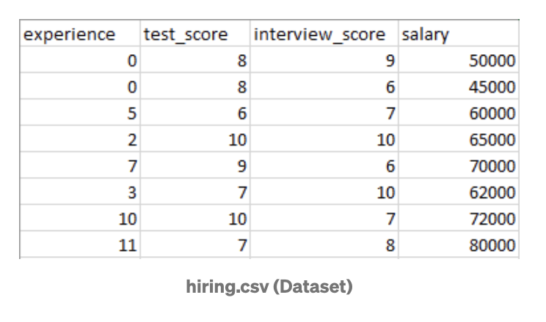
In this post, we will be building a simple regression model using scikit-learn’s built-in LinearRegression() function. First, let us have a look at how our data looks.
It’s a very simple data set with 4 attributes and 8 rows. All the columns are numerical columns, so we need to do any data pruning or cleaning up the data to convert categorical data into numerical before you build your classifier (regression model). This data used here is clean and is ready to be applied for a classifier.
Normally, you have to first clean up your data like filling up empty values in your data set, converting your categorical data into numerical data, normalization, etc; as part of our data cleaning and pruning. But this blog purpose is mainly serving the purpose of deploying the model using flask, so we have considered simpler data which is already clean and requires no further pre-processing.
Here, the class label will be the last salary column, which we will be predicting using our model. After our model is built, we will be saving our trained model using a library called pickle.

Slide 4
Pickle
Python pickle module is used for serializing and de-serializing a Python object structure. Any object in Python can be pickled so that it can be saved on disk. What pickle does is that it “serializes” the object first before writing it to file. Pickling is a way to convert a python object (list, dict, etc.) into a character stream. The idea is that this character stream contains all the information necessary to reconstruct the object in another python script.
Here’s the code of building a simple regression model and then saving the model by serializing it using pickle.

Slide 5
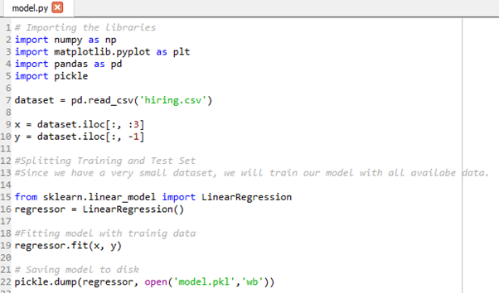

Slide 6
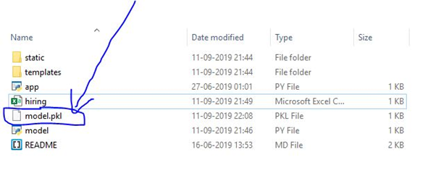
When you run this, your model is now trained and your model gets saved in the directory where your project files are stored in your local machine.

Slide 7
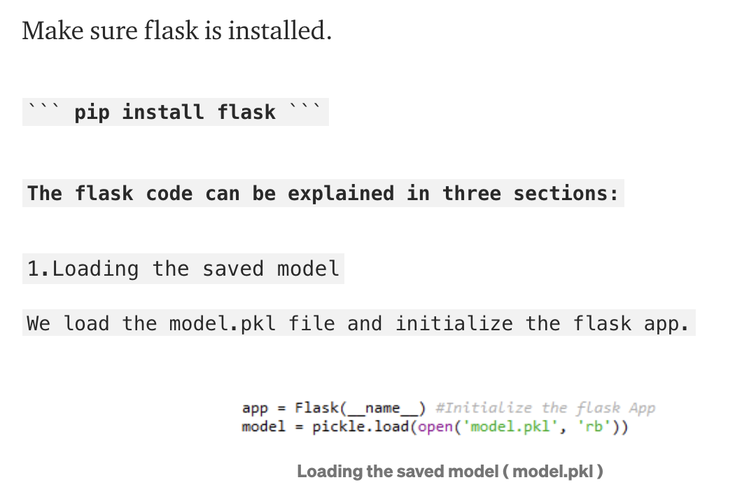
Setting up flask-app over the localhost:

Slide 8
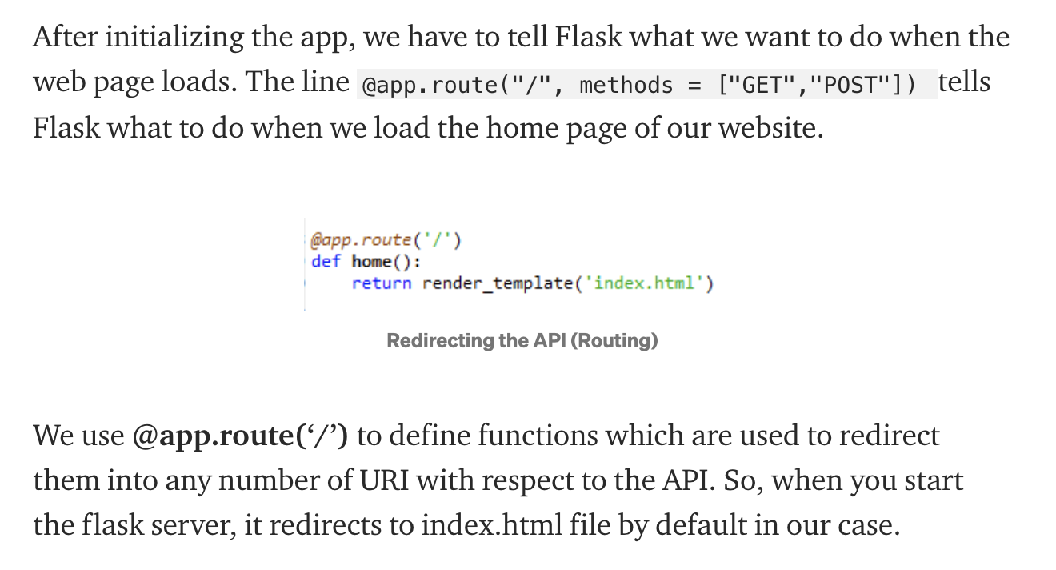
2. Redirecting the API to the home page index.html

Slide 9
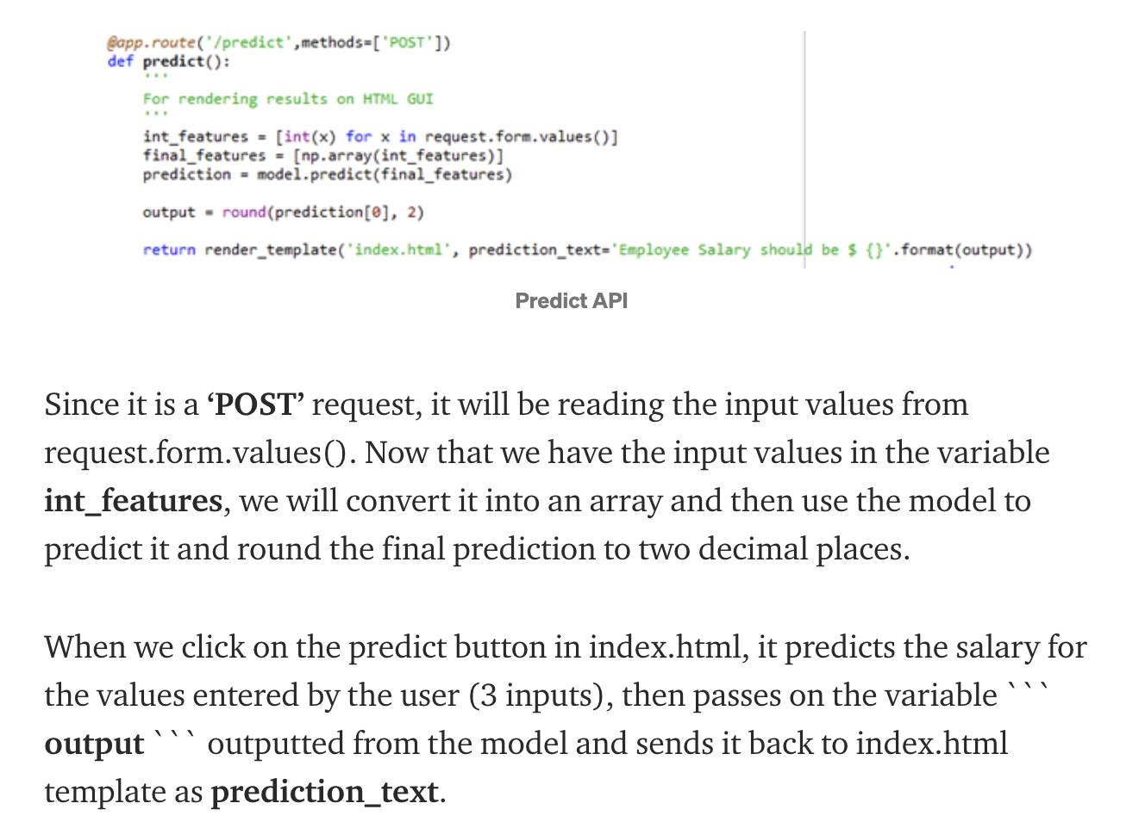
3. Redirecting the API to predict the result (salary)

Slide 10
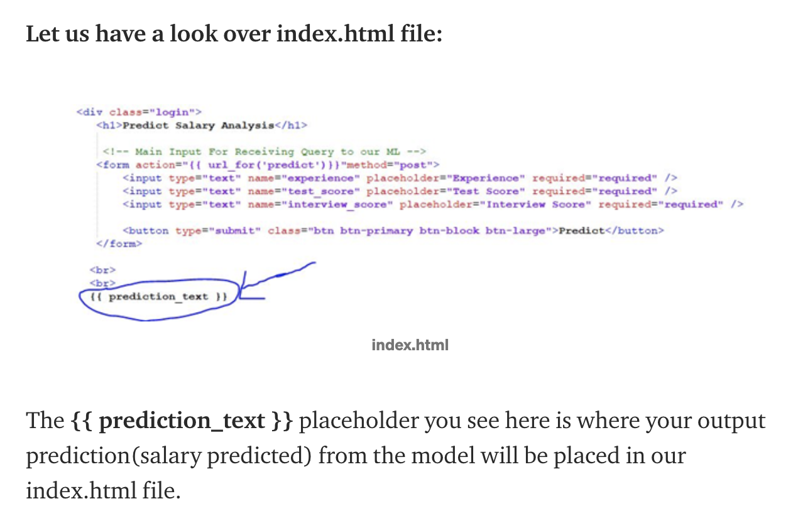

Slide 11
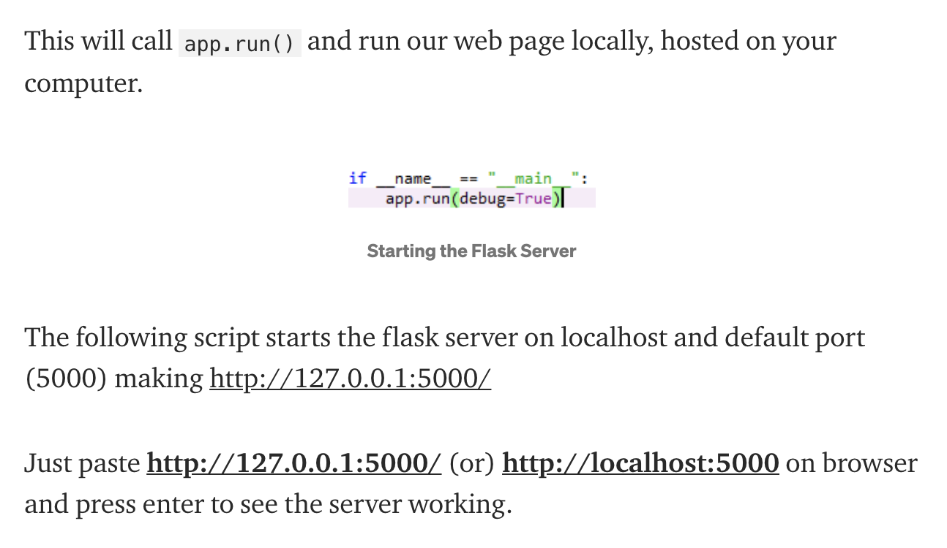
4. Starting the flask server

Slide 12
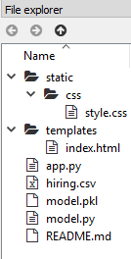
The overall structure of the project:
This project has four major parts:

Slide 13
Structure
1. model.py — This contains code for our Machine Learning model to predict employee salaries based on training data in ‘hiring.csv’ file.
2. app.py — This contains Flask APIs that receives employee details through GUI or API calls, computes the predicted value based on our model and returns it.
3. template — This folder contains the HTML template (index.html) to allow user to enter employee detail and displays the predicted employee salary.
4. static — This folder contains the css folder with style.css file which has the styling required for out index.html file.

Slide 14
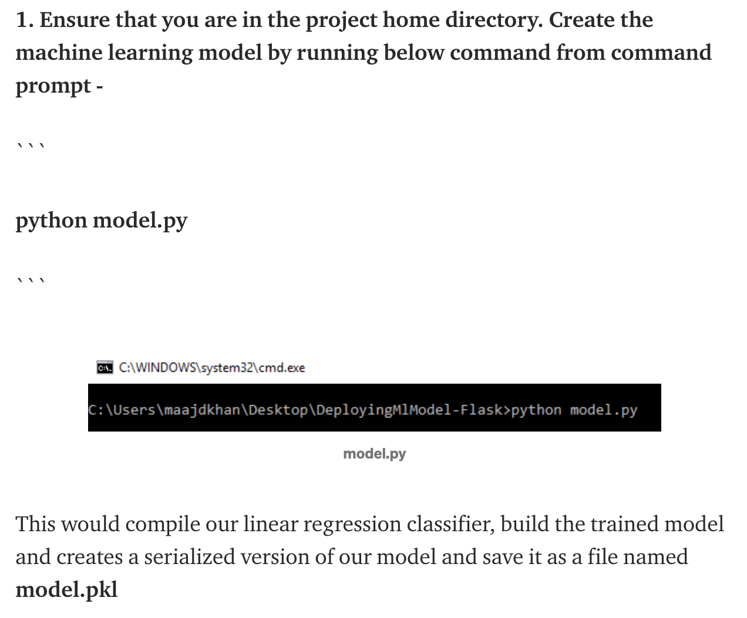
Running the project:

Slide 15
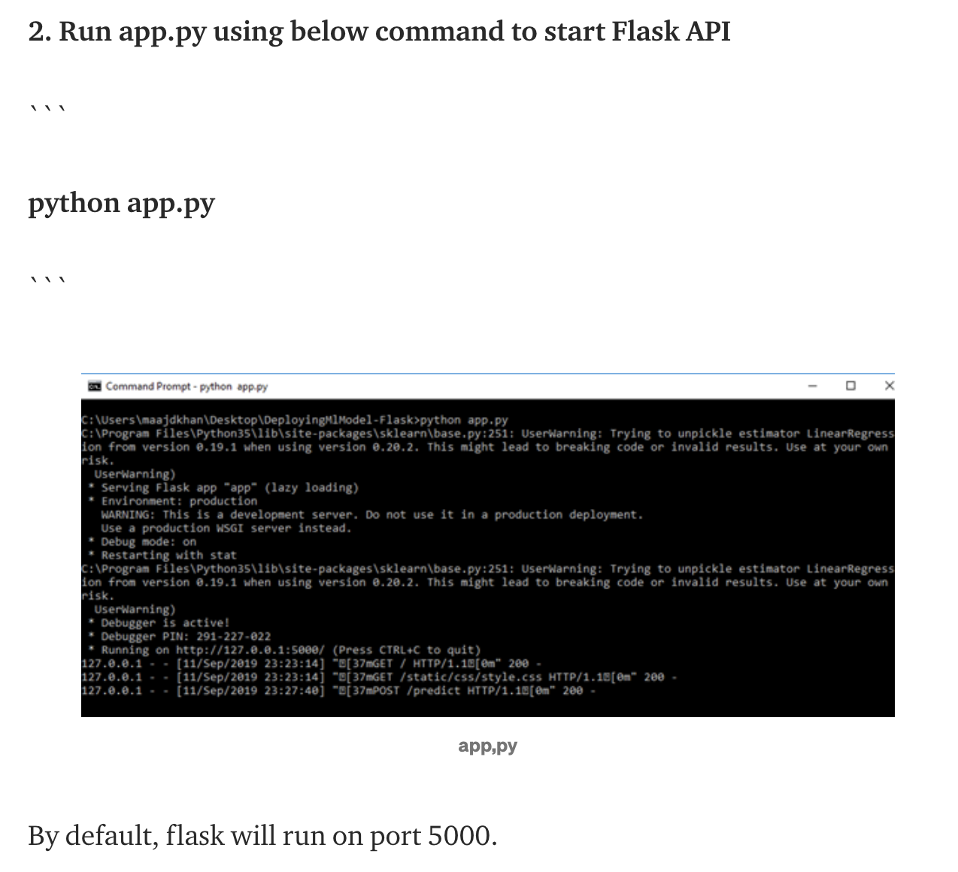

Slide 16
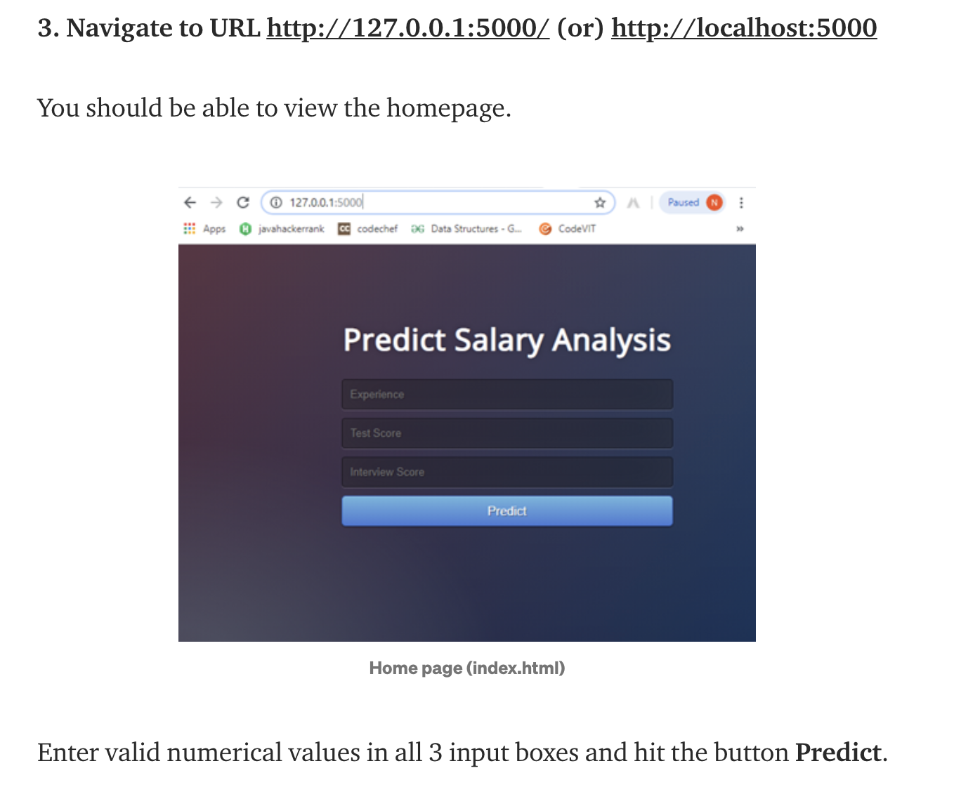

Slide 17
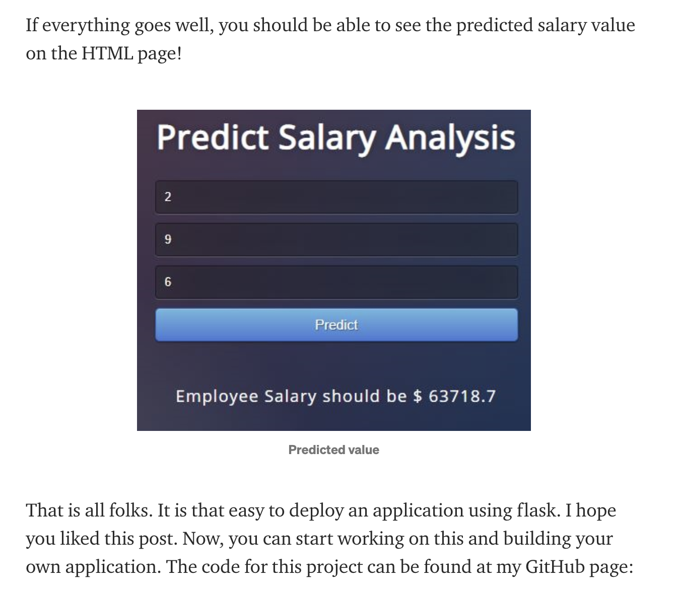

Slide 18
Reference
https://github.com/MaajidKhan/DeployMLModel-Flask
https://medium.com/datadriveninvestor/deploy-your-machine-learning-model-using-flask-made-easy-now-635d2f12c50c
https://towardsdatascience.com/how-to-easily-deploy-machine-learning-models-using-flask-b95af8fe34d4

